Slide 1
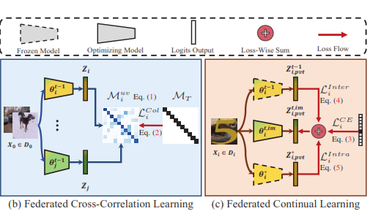
Summary of 2 papers for FCCLFramework
PFE day 13. 29/11/2022

Slide 2
Table of Content
Linear Model and optimal weights/estimator
Cross Correlation matrix Basics
Self-Supervised Learning
Weight stiffness relating to generalization
Knowledge distillation
Continual learning
Proposed Cross Correlation matrix
Server-Client side code Splitfed
Proposed Loss function

Slide 3
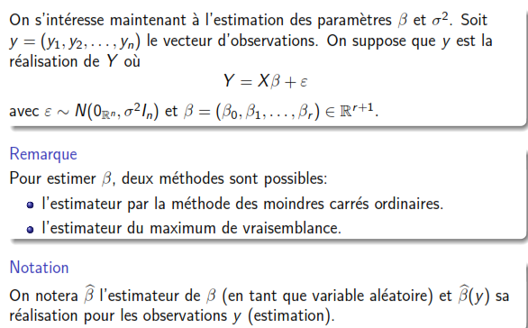
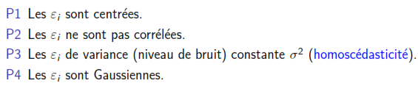
Linear Model and optimal weights/estimator

Slide 4
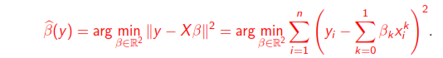
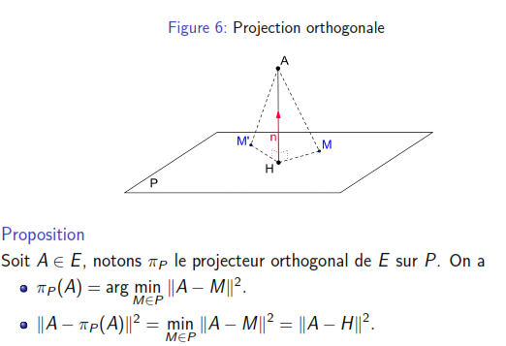
Linear Model and optimal weights/estimator

Slide 5
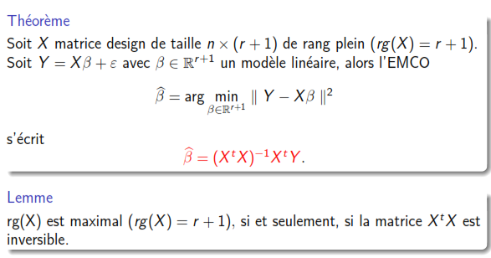
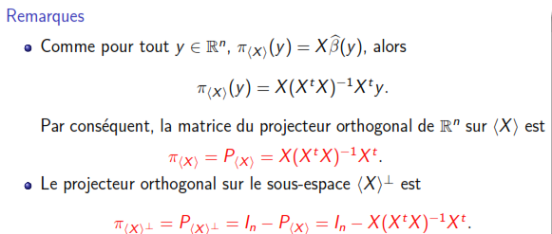
Linear Model and optimal weights/estimator

Slide 6
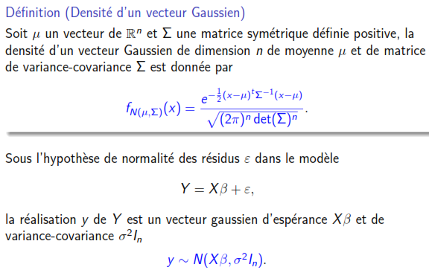
Linear Model and optimal weights/estimator

Slide 7
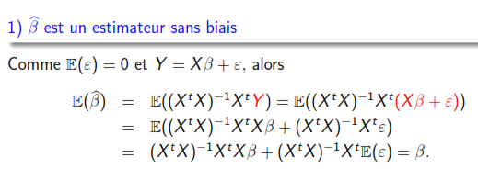
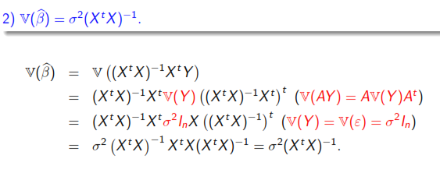
Linear Model and optimal weights/estimator

Slide 8
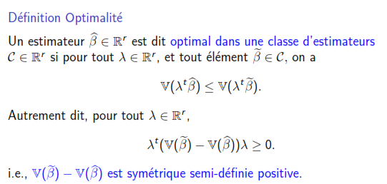
Linear Model and optimal weights/estimator

Slide 9
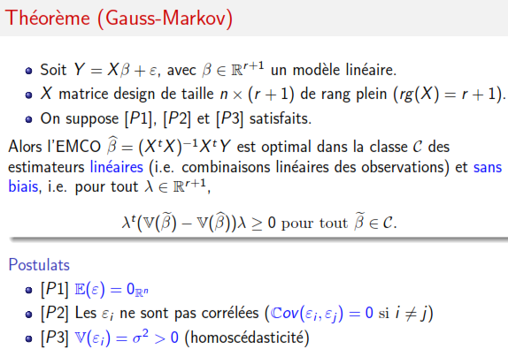
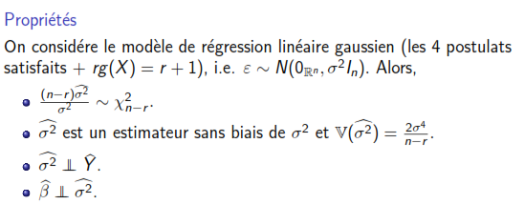
Linear Model and optimal weights/estimator

Slide 10
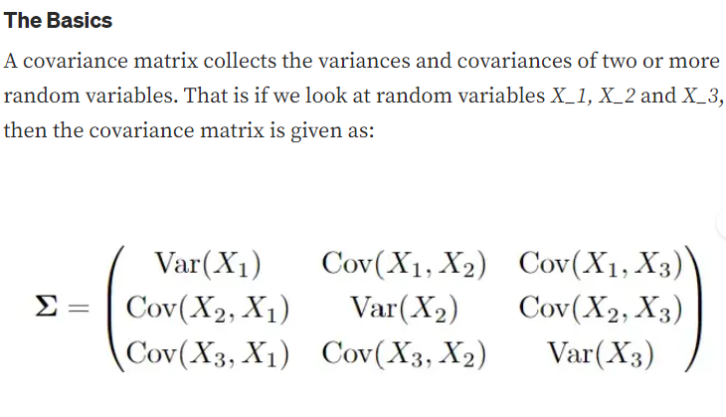
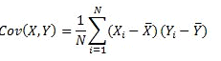
Cross Correlation matrix Basics

Slide 11
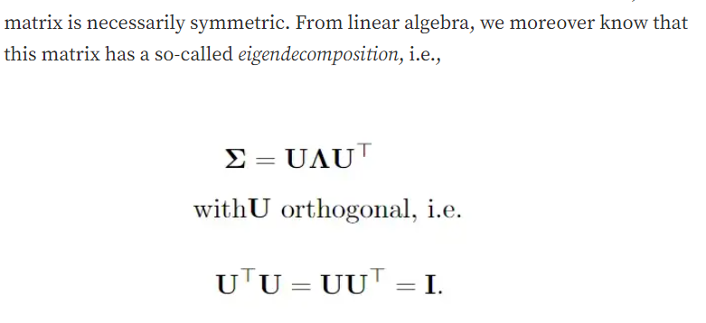
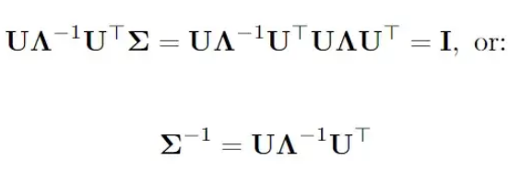
Cross Correlation matrix Basics
https://towardsdatascience.com/nonlinear-shrinkage-an-introduction-825316dda5b8

Slide 12
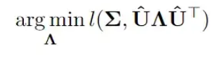
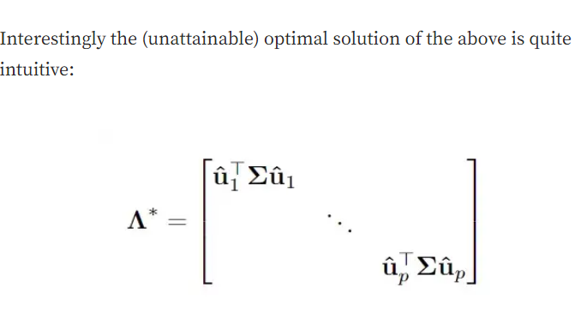
Linear Model and optimal weights/estimator

Slide 13
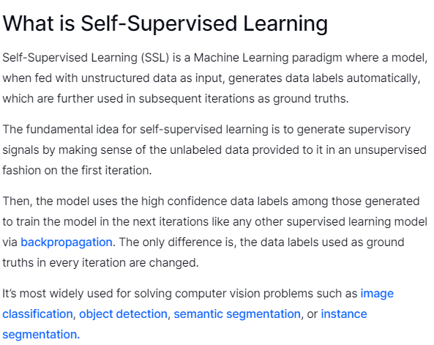
Self-Supervised Learning

Slide 14
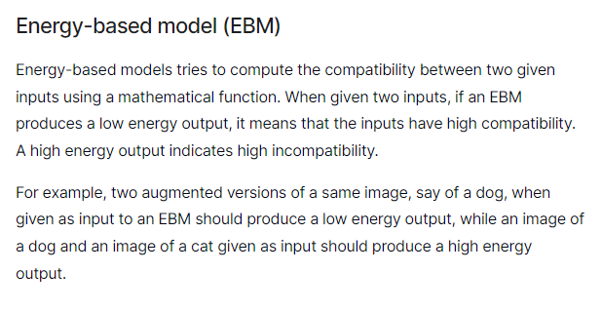
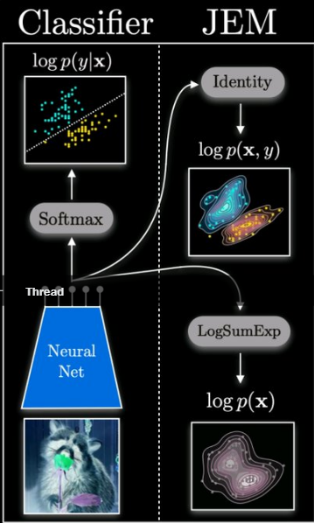
Self-Supervised Learning
https://arxiv.org/abs/1912.03263

Slide 15
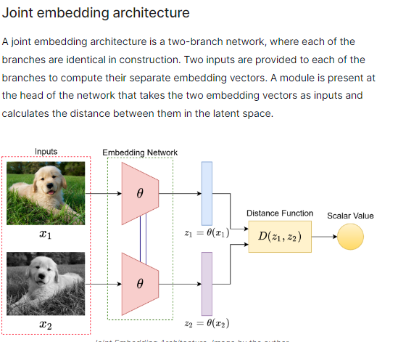
Self-Supervised Learning
https://www.v7labs.com/blog/self-supervised-learning-guide

Slide 16
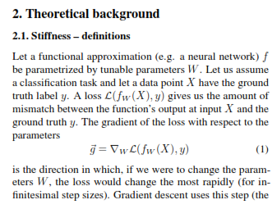
Weight stiffness relating to generalization

Slide 17
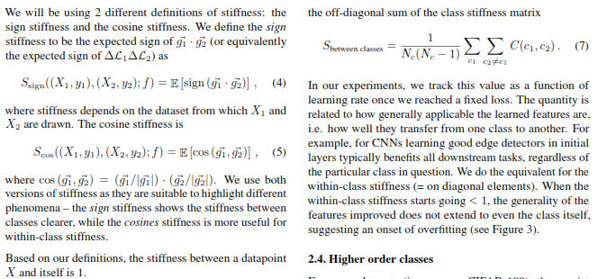
Weight stiffness relating to generalization
https://arxiv.org/pdf/1901.09491.pdf

Slide 18
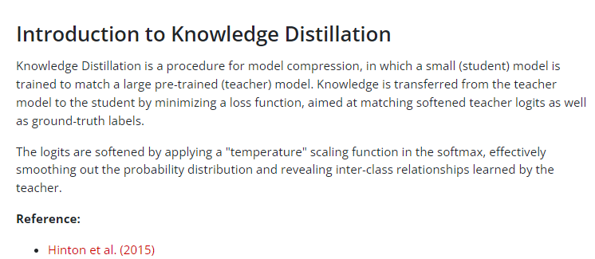
Knowledge distillation
https://keras.io/examples/vision/knowledge_distillation/

Slide 19
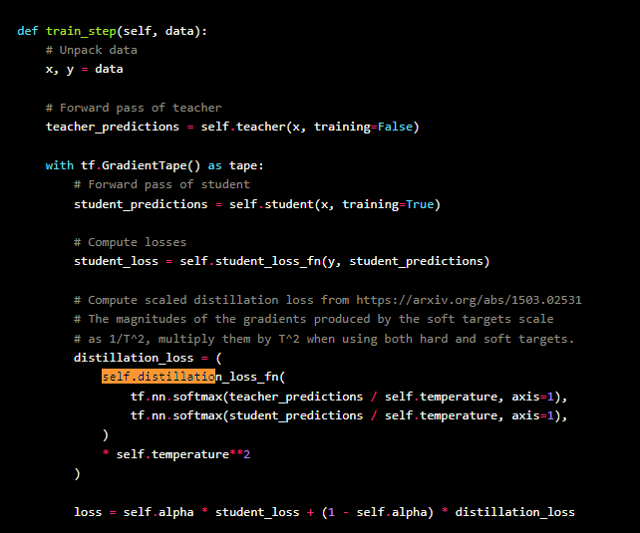
Knowledge distillation

Slide 20
Continual learning
https://arxiv.org/abs/2108.06325
https://www.youtube.com/watch?v=zEMOX3Di2Tc&t=5s&ab_channel=EdanMeyer
https://github.com/ZixuanKe/PyContinual/blob/main/src/networks/classification/cnn.py

Slide 21
Table of Contents
Continual Learning
FCCL
Improvements:
1-Inverse self suprvised Learning
2-BRU Activation function
3-Multi Modal graph representation
4-Other NN architecture
5-Meta learning
6-Use weight stiffness as information
7-Conv layer to create feature vectors+GMM
8-Deviance

Slide 22
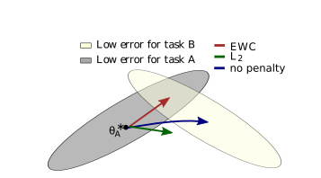
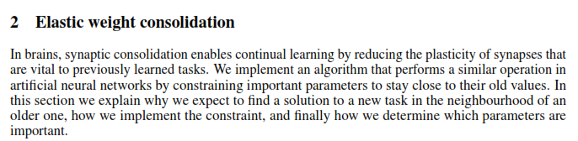
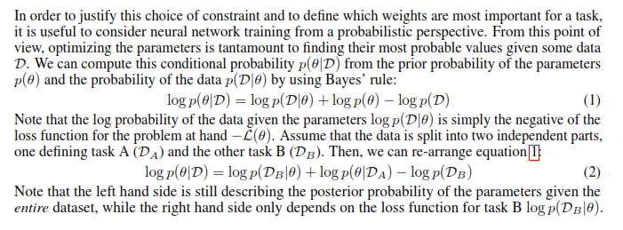
Continual Learning

Slide 23
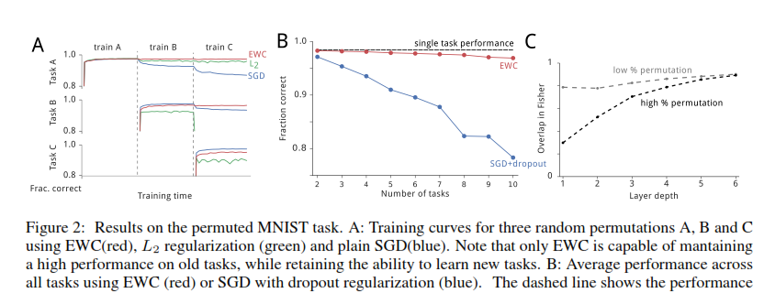
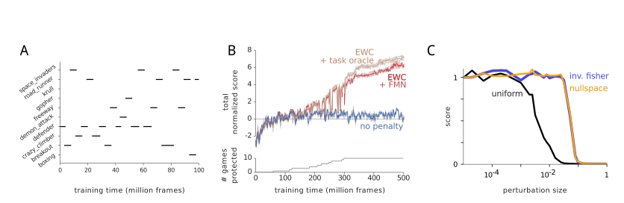
Single Task and Multiple Task Performance

Slide 24
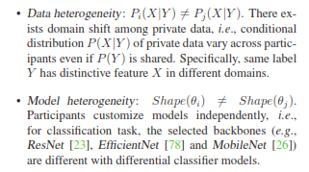
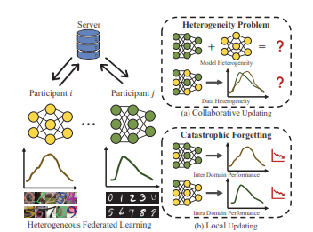
FCCL

Slide 25
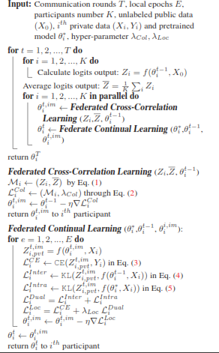
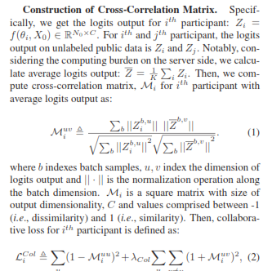
FCCL

Slide 26
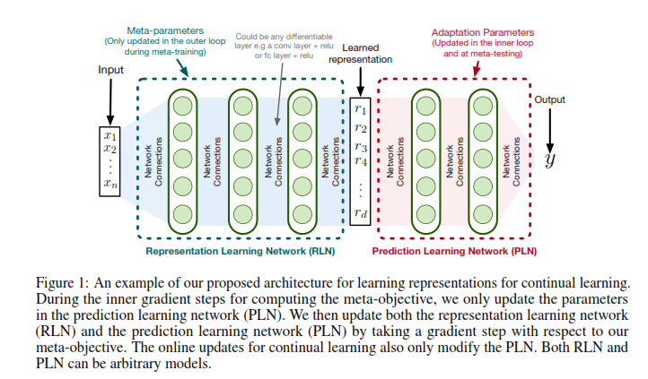
Meta Learning

Slide 27
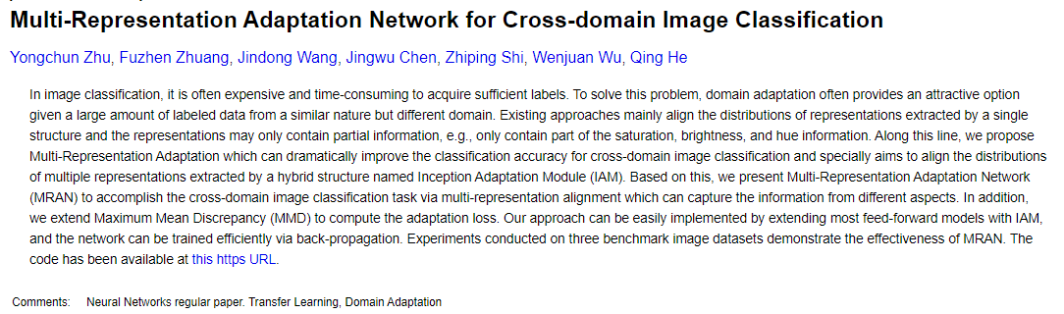
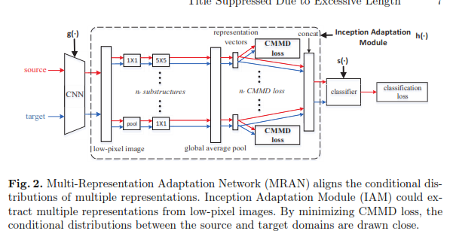
3-Multi Modal graph representation : Domain specific feature learning

Slide 28
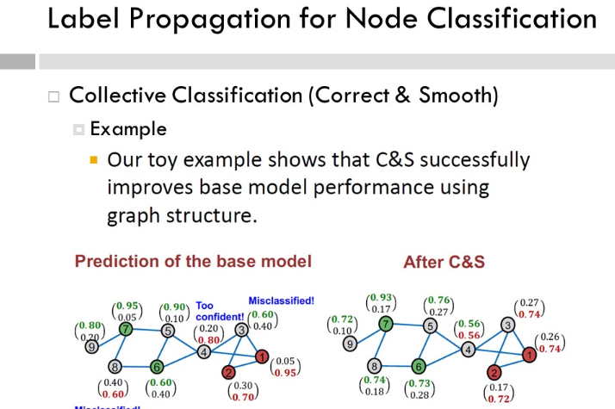
3-Multi Modal graph representation : Label propagation

Slide 29
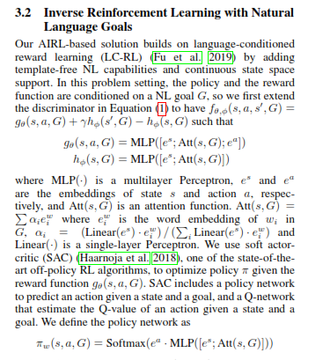
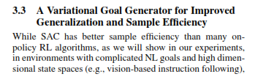
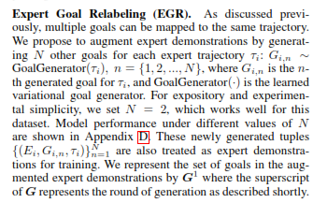
Inverse self suprvised Learning

Slide 30
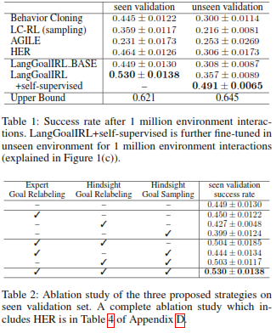
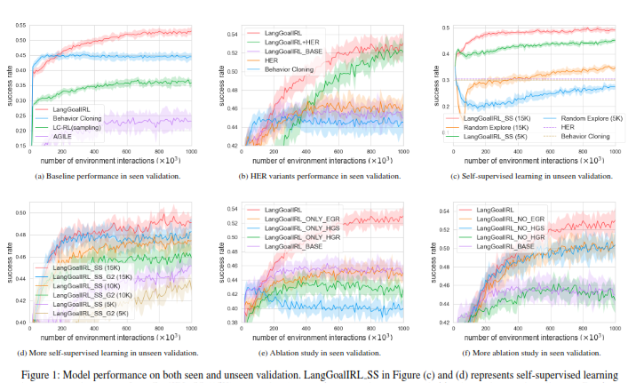
Inverse self-suprvised Learning

Slide 31
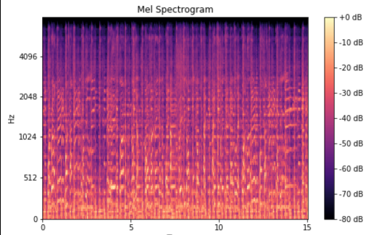
Use Audio Data Augmentation techniques 6-Use weight stiffness as information 7-Conv layer to create feature vectors+GMM

Slide 32
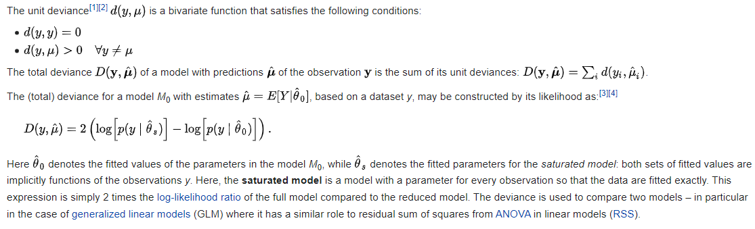
Deviance

Slide 33
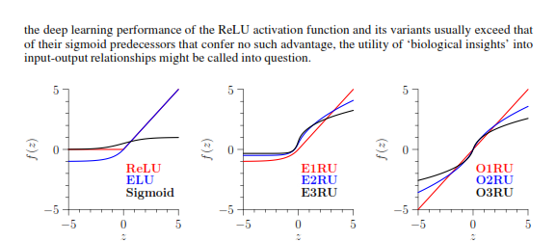
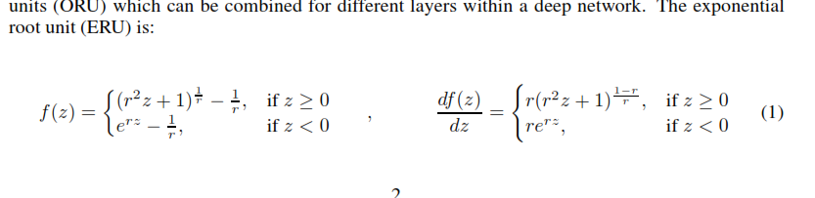
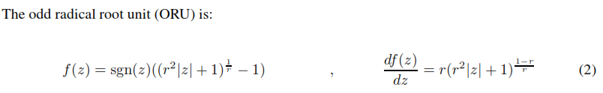
BRU Activation functions

Slide 34

BRU Activation functions : Loss and generlization

Slide 35

BRU Activation functions : Speed

Slide 36


4-Other NN architectures

Slide 37


4-Other NN architectures

Slide 38
Table of Contents
The state of Graphs and Federated Learning
Benchmarks for graph neural network
Proposed Reinforced Continual learning (Sept ’22)

Slide 39

The state of Graphs and Federated Learning

Slide 40

The state of Graphs and Federated Learning

Slide 41
The state of Graphs and Federated Learning
Besides showcasing the utility of FedGraphNN, there are multiple takeaways from these results:
1.When the graph datasets are small, FL accuracy is often on par with centralized learning.
2.When dataset sizes grow, FL accuracy becomes signiﬁcantly worse than centralized learning.
We conjecture that it is the complicated non-I.I.D. nature of graphs that leads to the accuracy drop in larger datasets.
3.The dynamics of training GNNs in a federated setting are different from training federated vision
or language models. Our ﬁndings show that the best model in the centralized setting may not
necessarily be the best model in the FL setting.
4.Counterintuitive phenomenons (highlights in above tables) further add to the mystery of federated
graph neural networks: in graph-level experiments, GAT suffers the most performance
compromise on 5 out of 9 datasets; in both subgraph-level and node-level FL, results on some
datasets (CIAO, CORA, PubMed) may even have slightly higher performance than centralized
training; GAT cannot achieve reasonable accuracy in node-level FL (e.g., in CORA dataset),

Slide 42

Benchmarks for graph neural network

Slide 43

Benchmarks for graph neural network

Slide 44

Proposed Continual learning (Sept ’22)

Slide 45


Proposed Continual learning (Sept ’22)

Slide 46

Proposed Continual learning (Sept ’22)

Slide 47

Proposed Continual learning (Sept ’22)

Slide 48

Proposed Continual learning (Sept ’22)

Slide 49
Thanks for your attention !

